Slide 1

A Computation Framework for Slang Generation
Zhewei Sun, Richard Zemel, and Yang Xu
Department of Computer Science
University of Toronto

Slide 2
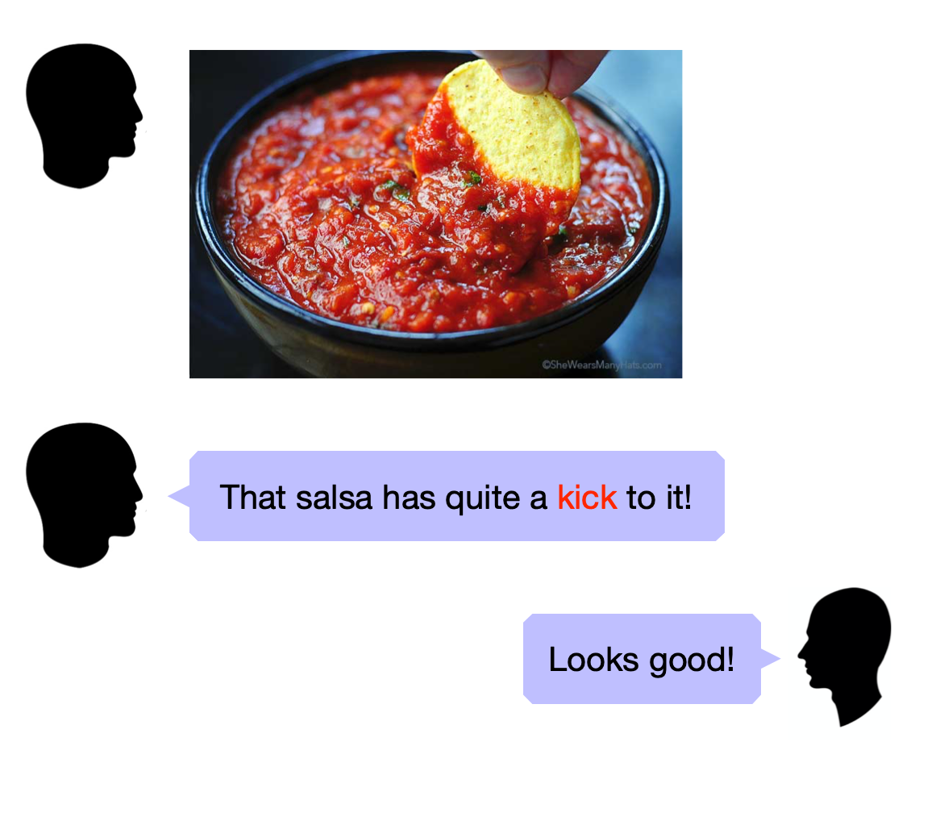
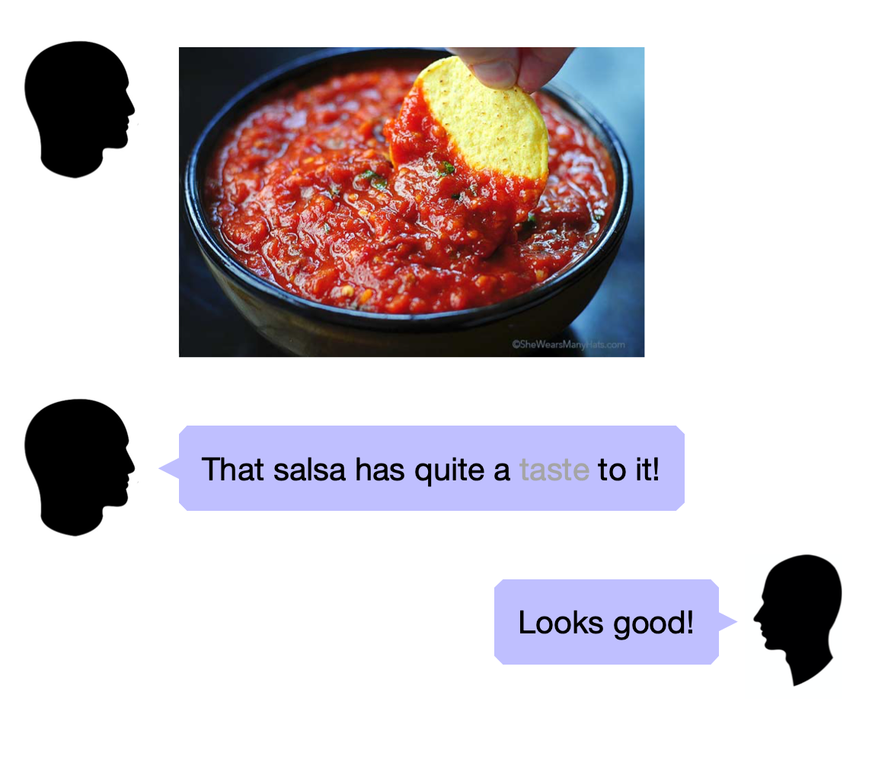

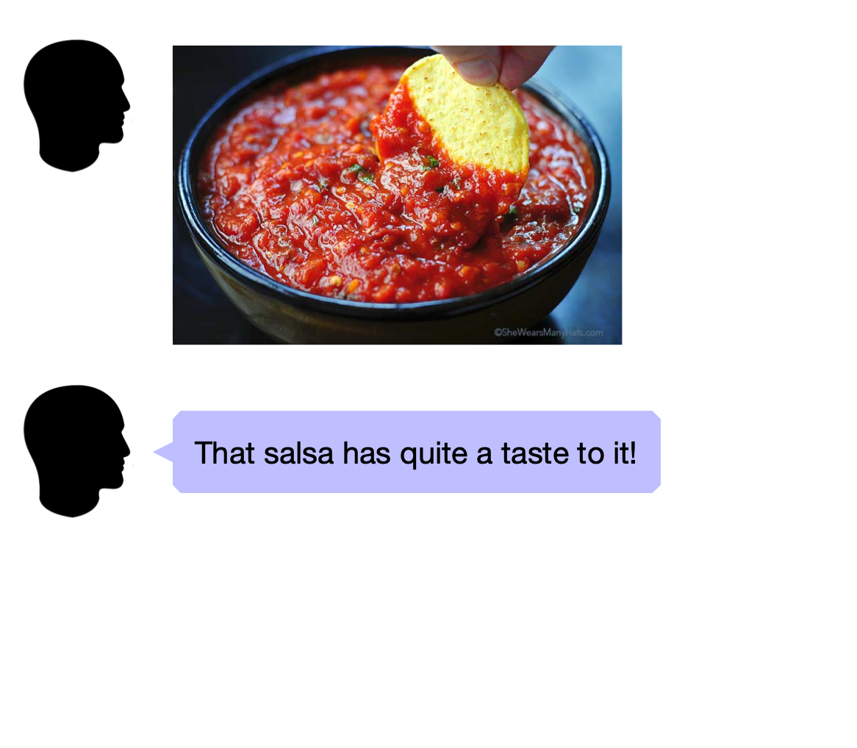
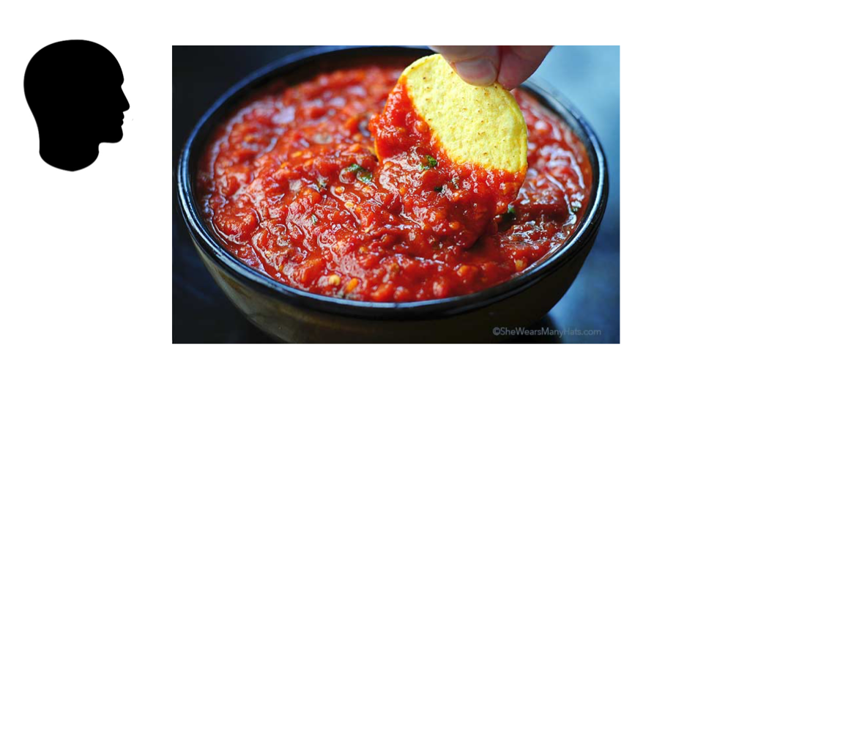
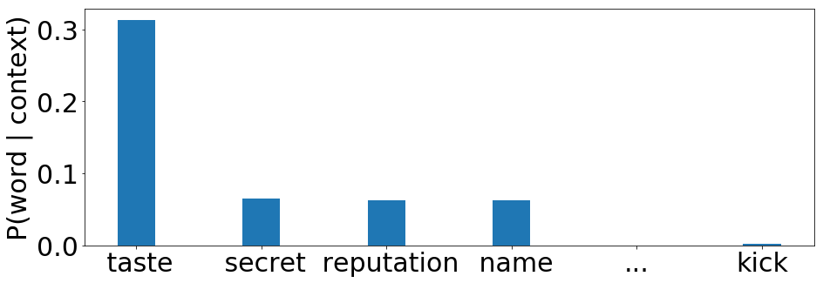
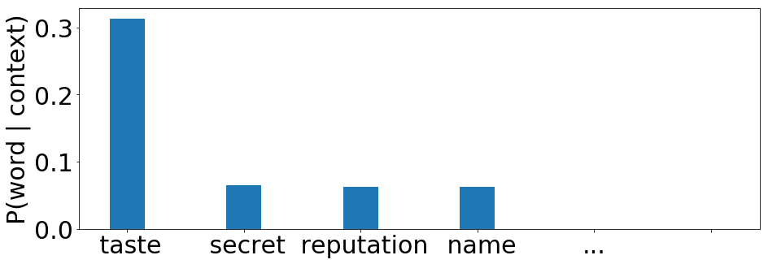
Slang in Natural Language Processing
GPT2_LM ( “That salsa has quite a ___ to it.” )

Slide 3
Motivation
Slang is prevalent in natural text, but understudied in NLP!
Previous work has looked at how to process slang using the surrounding context:
Seq2seq-based translation models for slang interpretation [Ni and Wang, 2017]
BiLSTM-CRF based models for slang detection [Pei et al., 2019]
The slang word itself provides valuable cues about the intended meaning.
How to model the semantics of slang?
Why certain words are picked to express a given meaning?

Slide 4
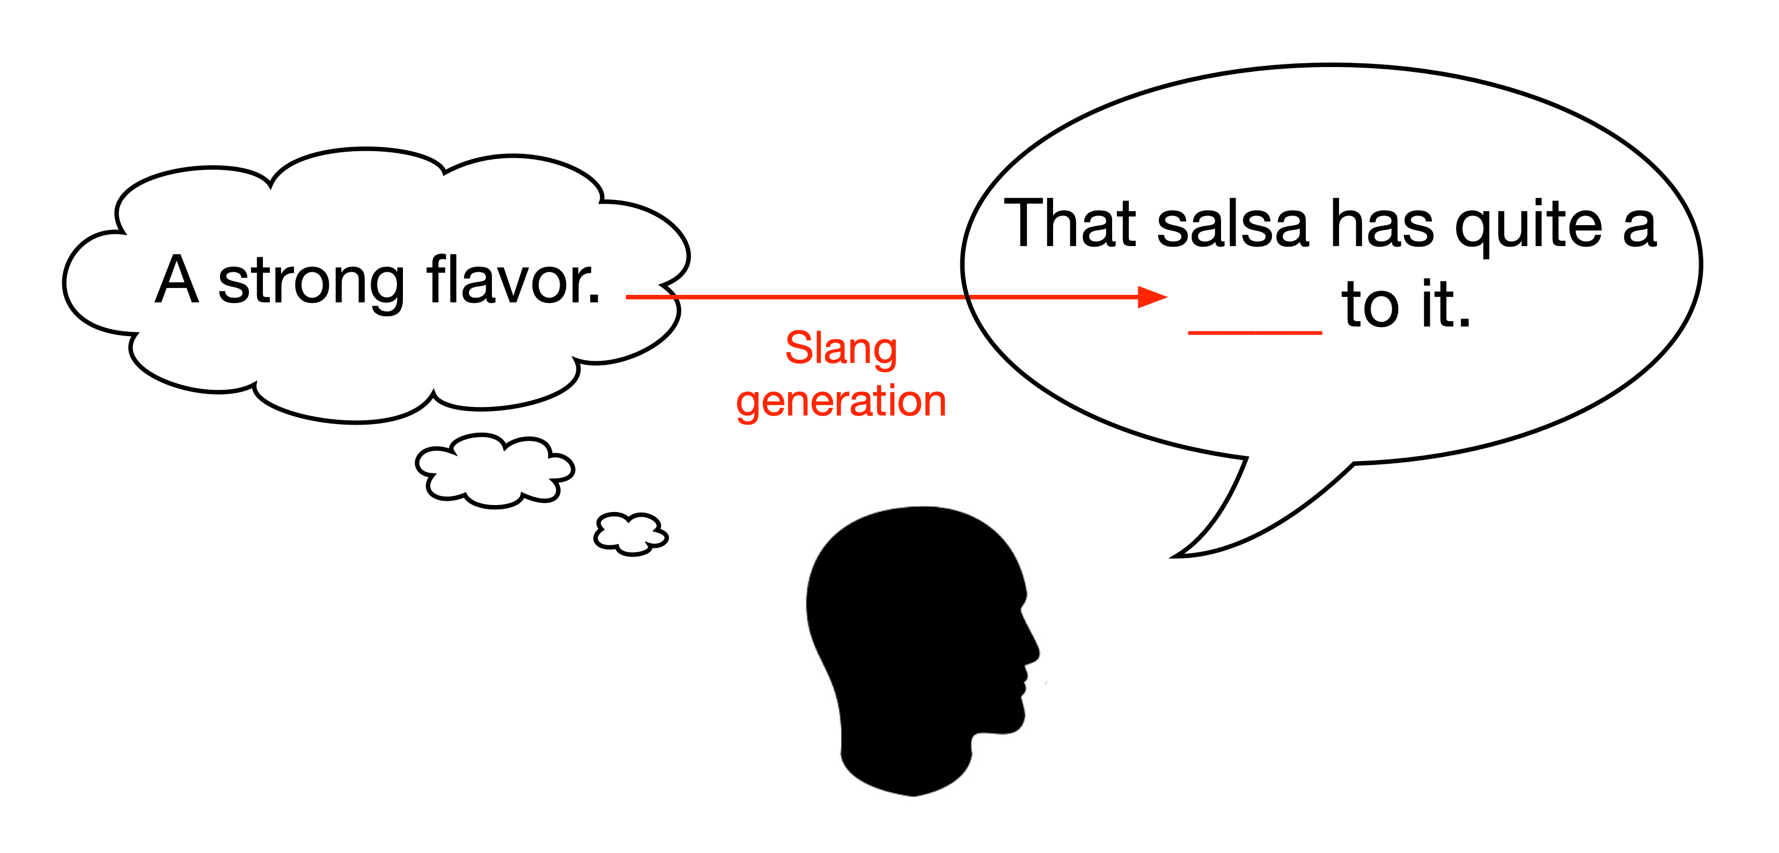
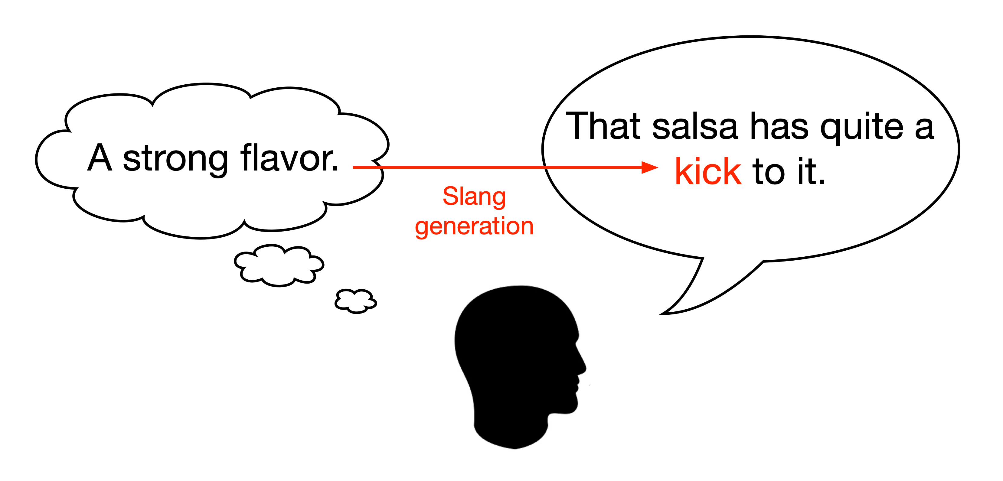
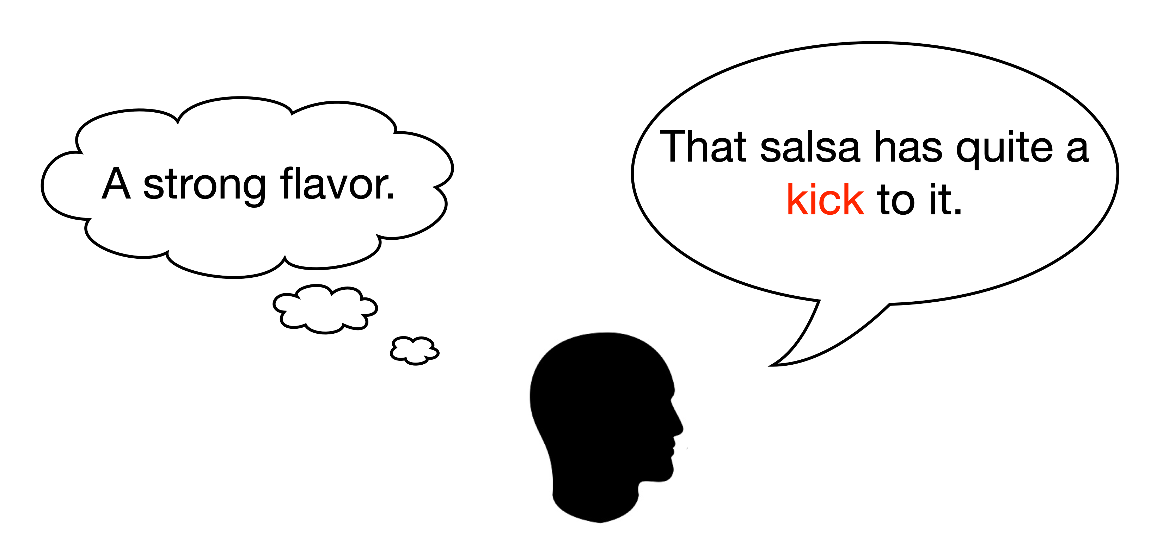
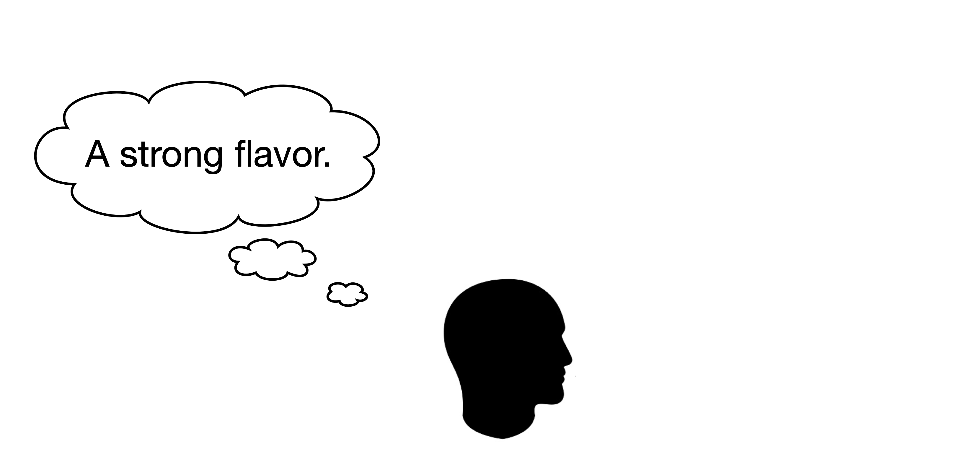
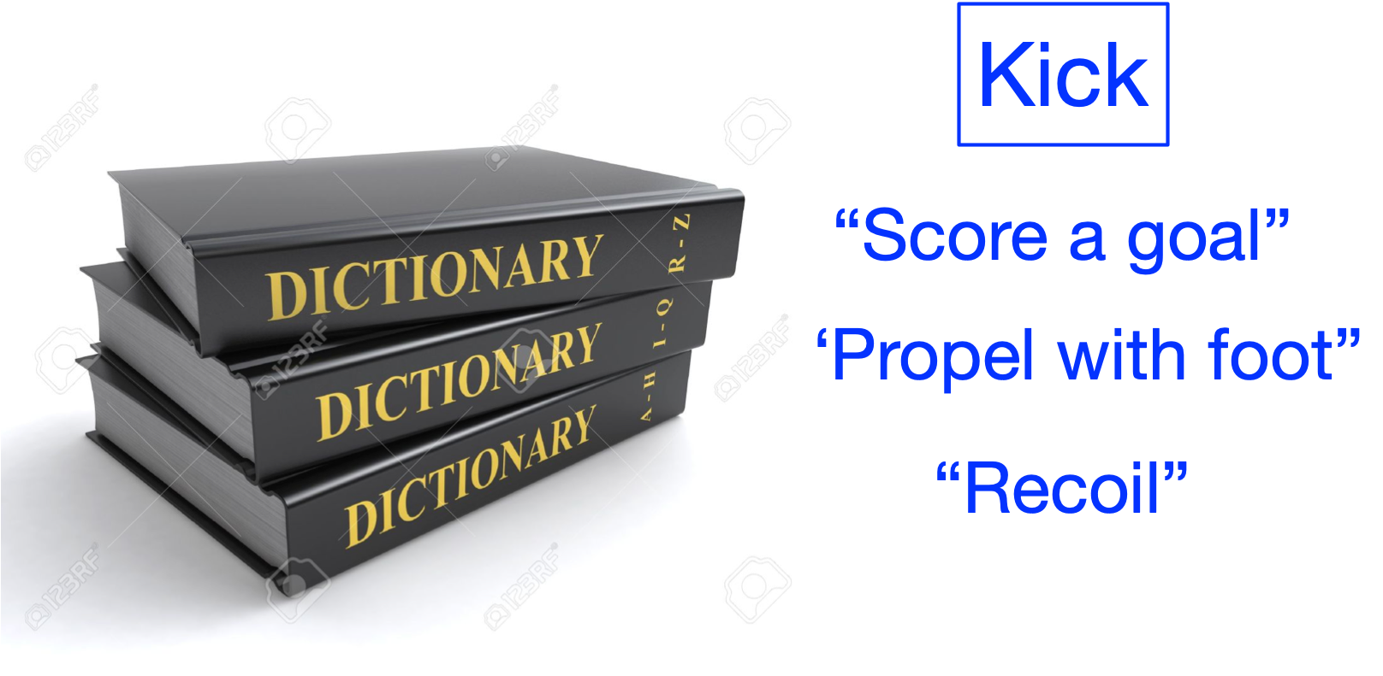
Slang Generation

Slide 5
Datasets
Slang word-definition pairs from dictionaries:
Online Slang Dictionary (OSD)
1,635 words and 2,979 slang definition sentences.
Contains POS and example usage context.
Green’s Dictionary of Slang (GDoS)
6,540 words and 29,300 slang definition sentences.
Contains POS and time of emergence.
Urban Dictionary (UD)
1.464 words and 2,631 slang definition sentences.
Conventional senses from Online English Dictionary by Oxford (OD)
Urban data available at https://github.com/zhewei-sun/slanggen
Notes:
Example data entry

Slide 6
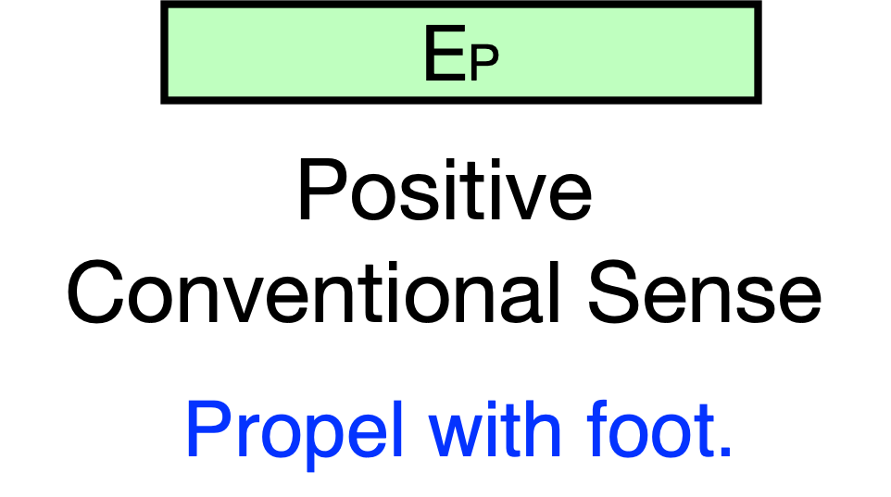
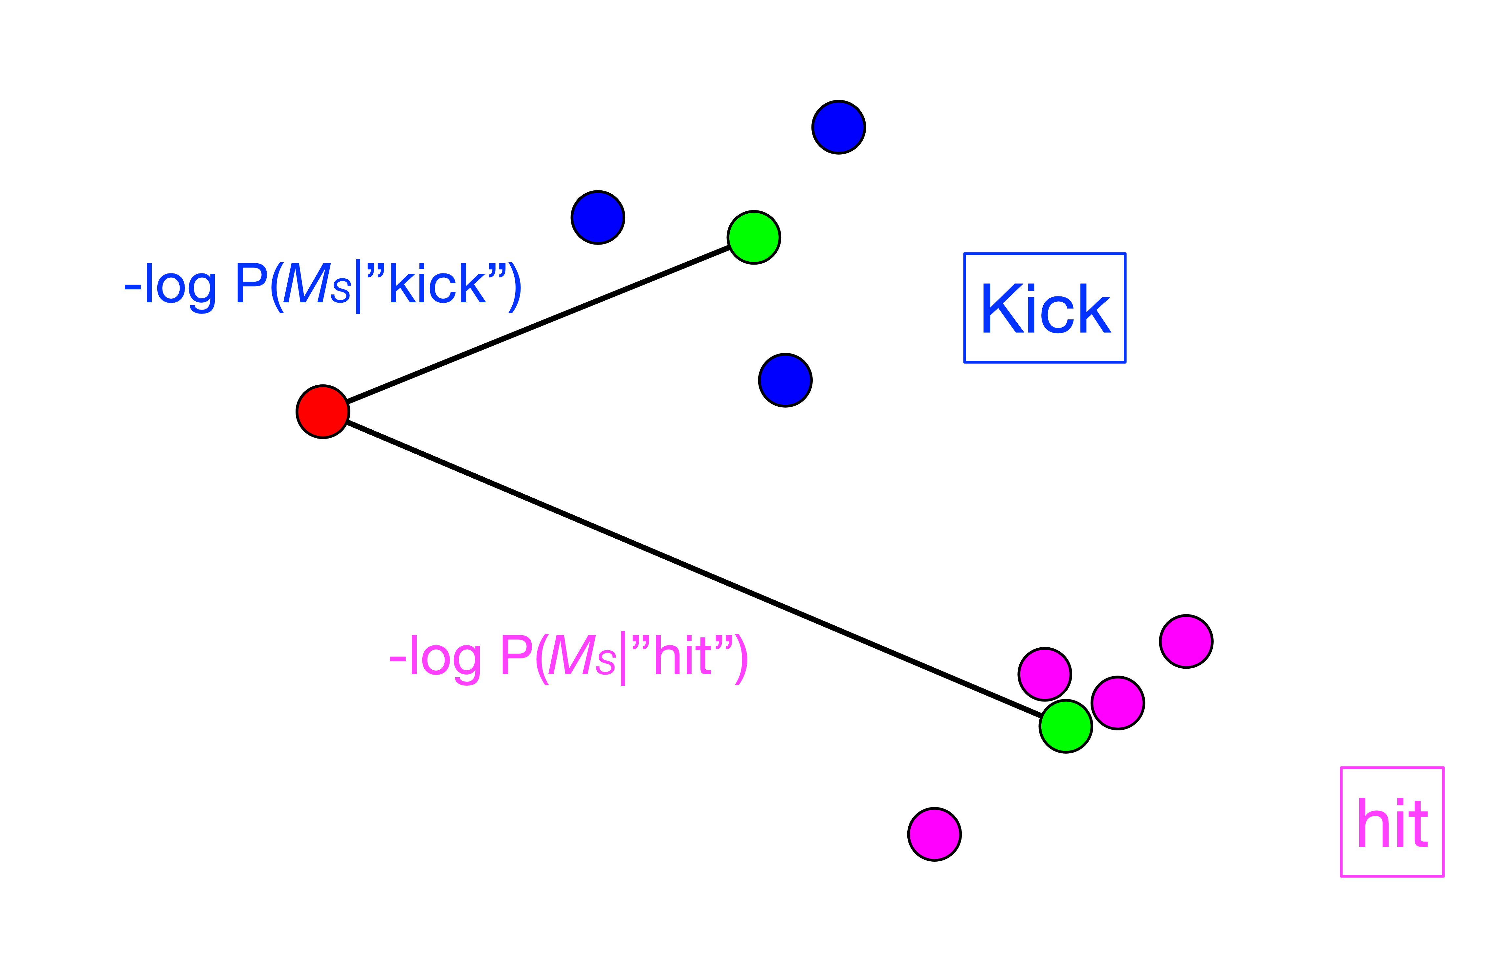
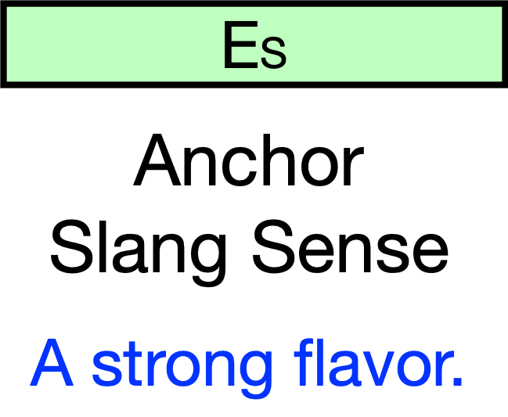
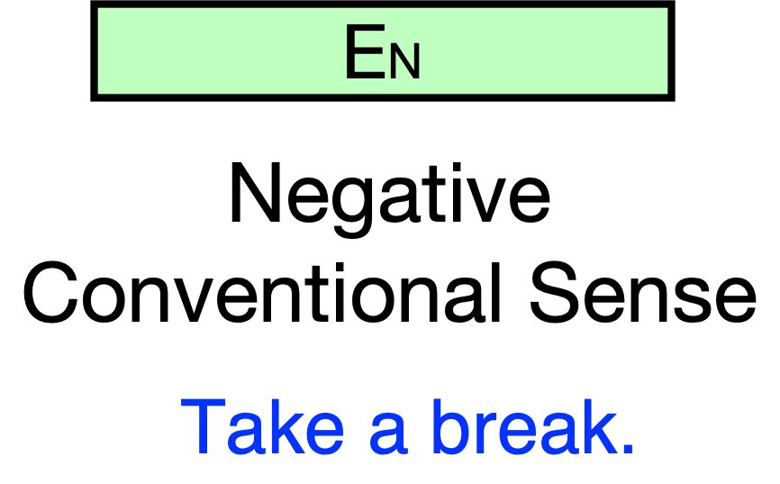
Computational Framework - Overview
Contextual prior model that makes a prediction based on the usage context.
Semantic model based on few-shot learning that matches the input slang sense to candidate words with close conventional senses.
Contrastively learned sense representation extracted from pairs of corresponding slang and conventional senses from data.

Slide 7
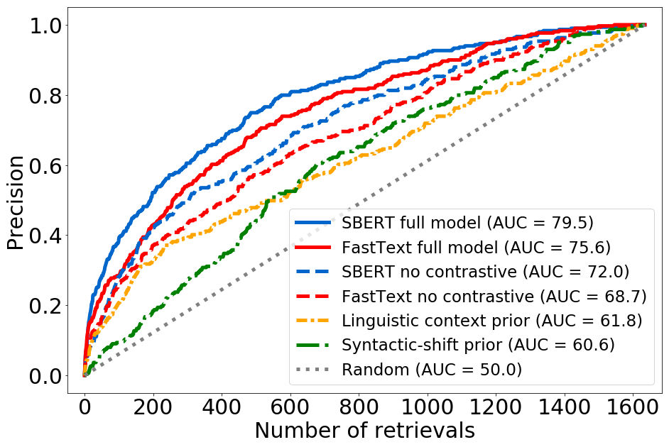
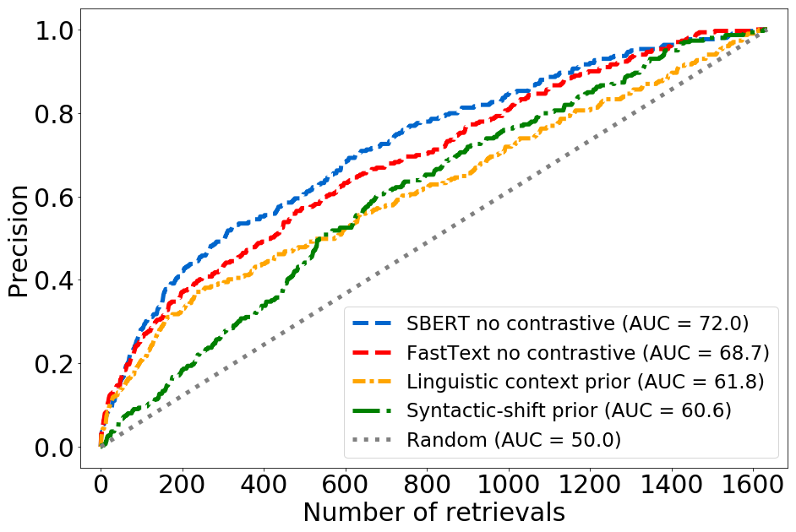
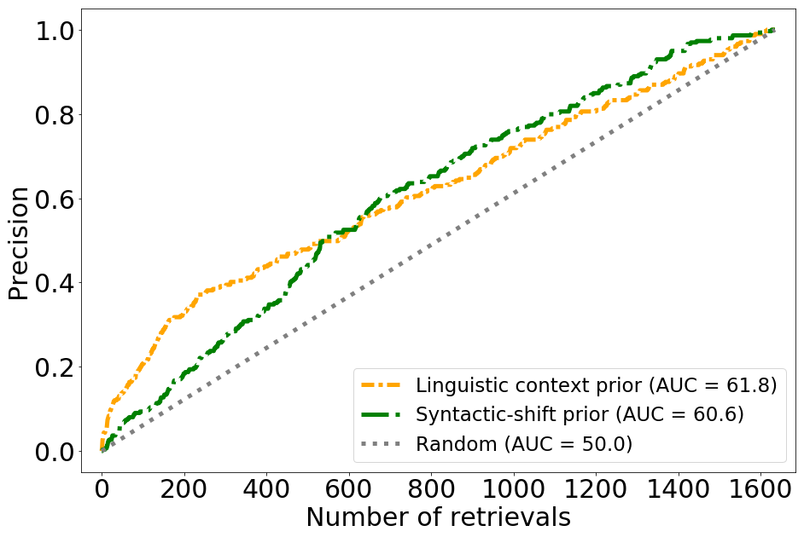
Results – Predicting Slang Word Choice
ROC curves for Online Slang Dictionary (OSD) test set:
Notes:
Example data entry

Slide 8
Results - Summary
We find similar results across all three datasets, consistent in cases where contextual information may not be available.
Novel slang usages can be predicted by training on historically emerged slang.
Contrastive training indeed brings closer the slang senses and their corresponding conventional senses. The effect is significant even on the test sets!

Slide 9
Conclusion
There exist predictable patterns of semantic shift in novel slang usages.
Few-shot and contrastive learning schemes can be applied to extract such patterns from dictionary data.
The learned patterns can be used to generate flexible slang word usages that are novel.
Notes:
Example data entry

Slide 10


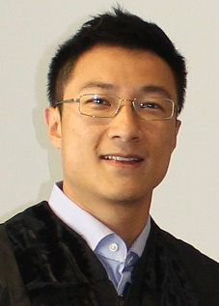
Thank you!
Code and data: https://github.com/zhewei-sun/slanggen
Link to paper: https://doi.org/10.1162/tacl_a_00378
Zhewei Sun
University of Toronto
Richard Zemel
University of Toronto
Vector Institute
Yang Xu
University of Toronto
Vector Institute
Notes:
Example data entry

